Slide 1
Neural Network I
Chul Min Yeum
Assistant Professor
Civil and Environmental Engineering
University of Waterloo, Canada
CIVE 497 – CIVE 700: Smart Structure Technology
Last updated: 2020-03-27

Slide 2
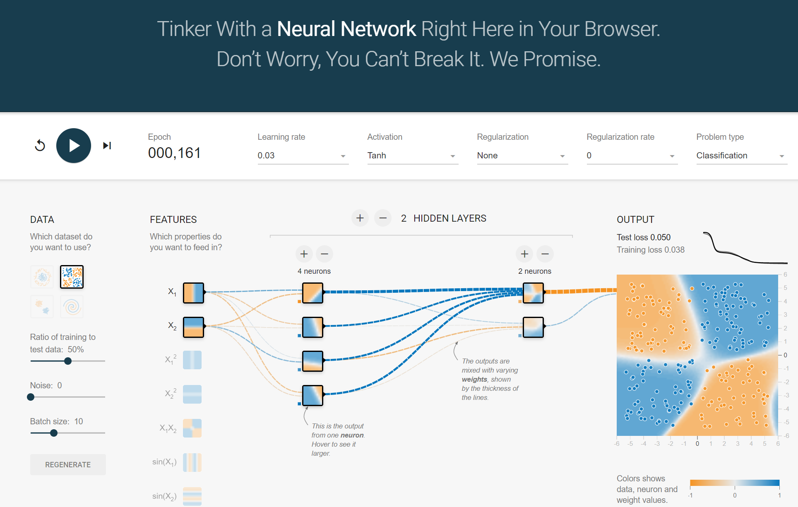
Neural Network Playground
http://playground.tensorflow.org/

Slide 3
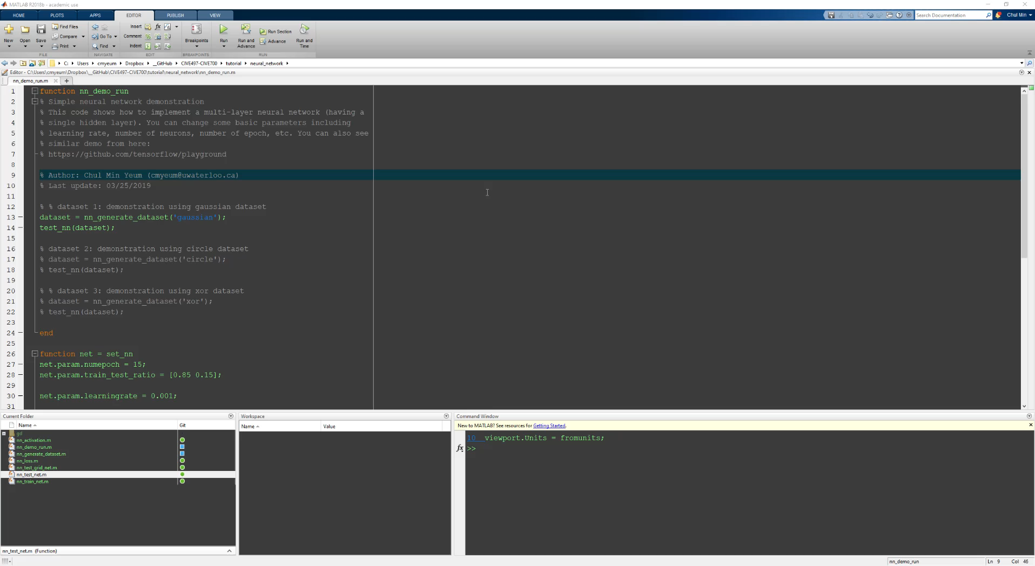
Tutorial: Binary Classification (Gaussian)

Slide 4
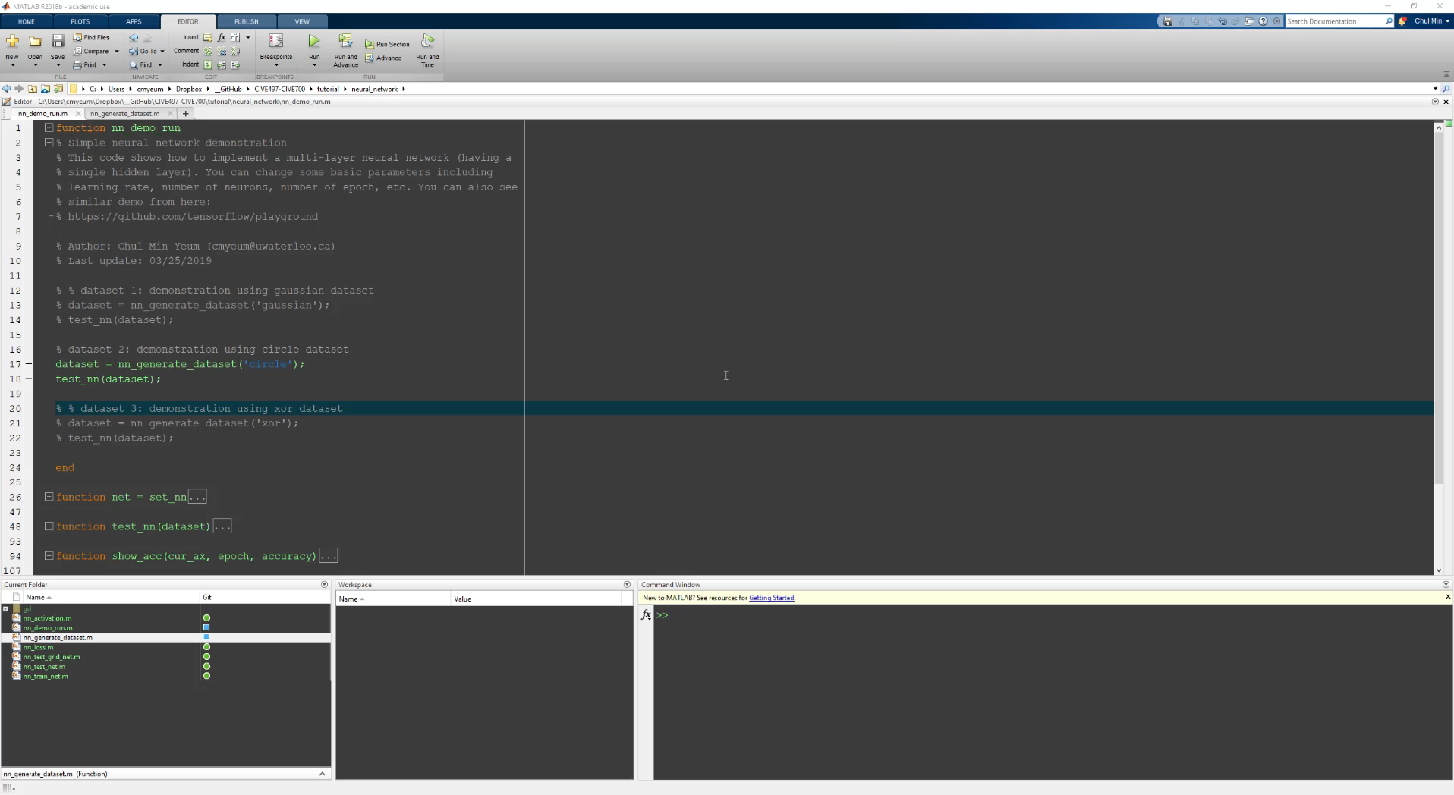
Tutorial: Binary Classification (Circle)

Slide 5
Supervised Neural Networks
Inputs
Learn (Input, Output)
updates internal state
Outputs
updates internal state
Predict from (inputs)
Inputs
Outputs

Slide 6
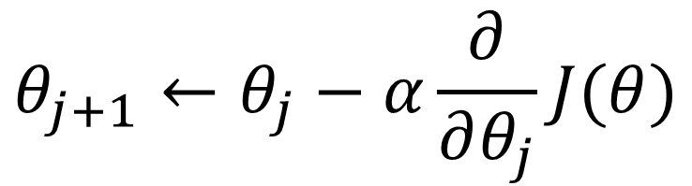
Gradient Descent
Gradient descent is an iterative machine learning optimization algorithm to reduce the cost function so that we have models that makes accurate predictions.
Cost function(J) or loss function measures the difference between the actual output and predicted output from the model.
$$θ_{j+1}←θ_{j}−α\frac{∂}{∂θ_{j}}J(θ)$$
Repeat until convergence

Slide 7
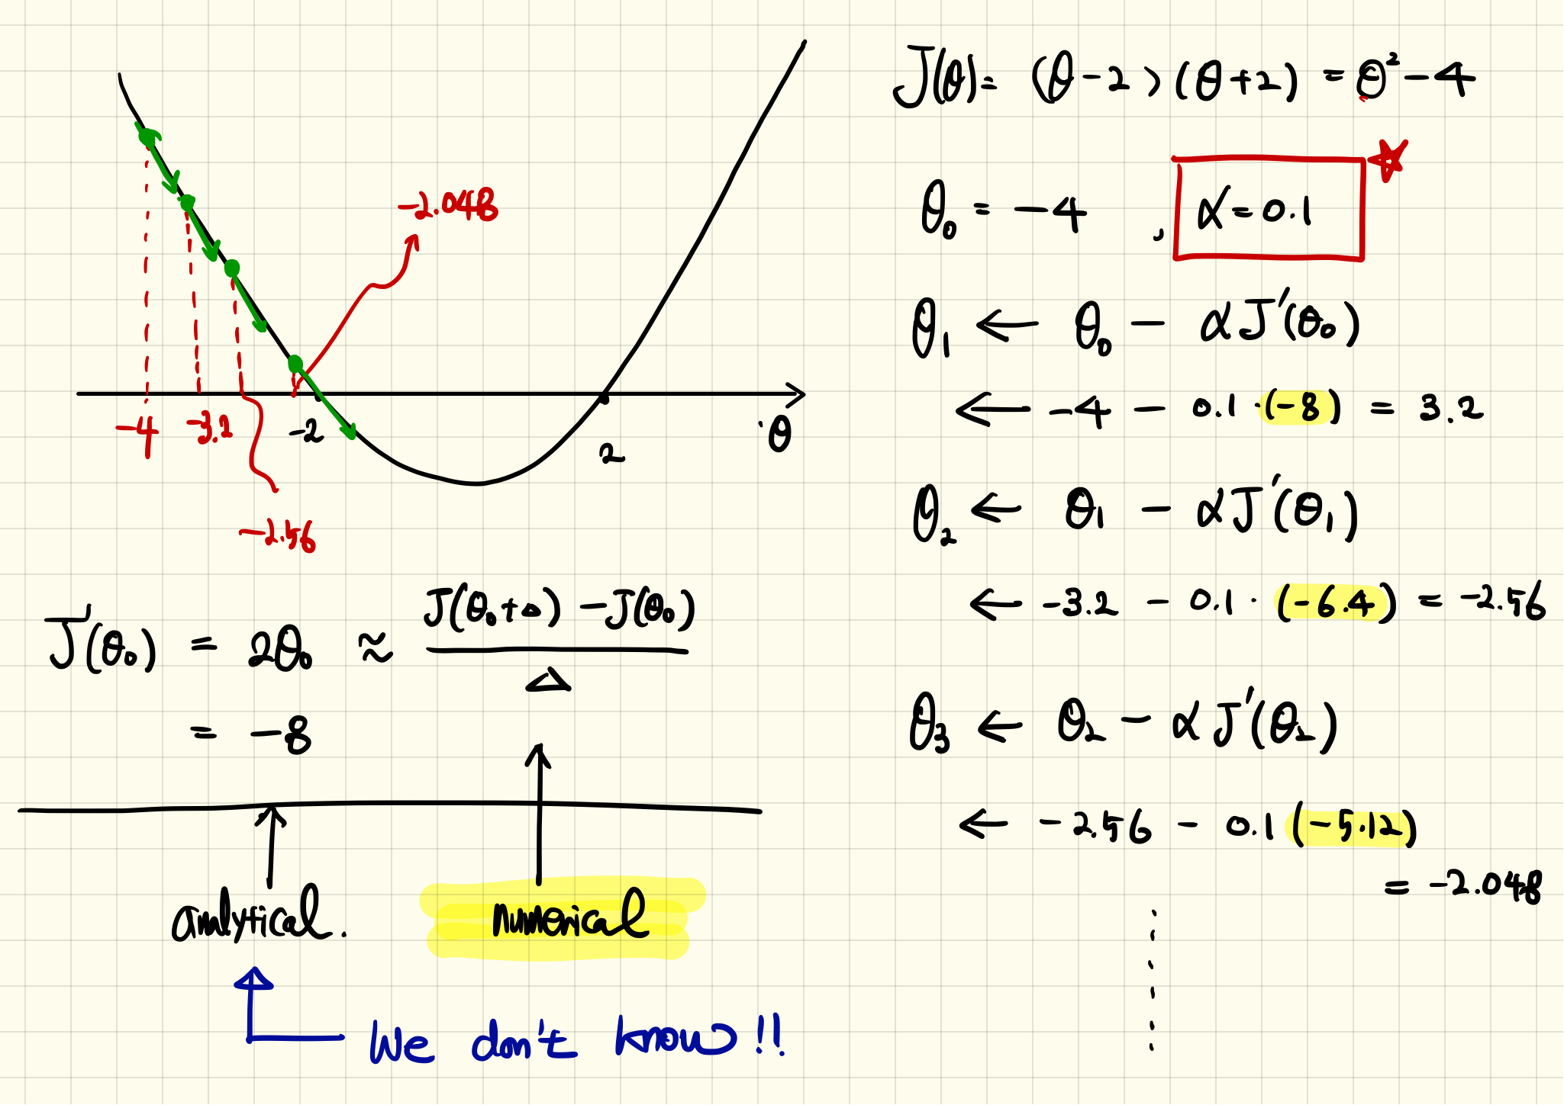
Example: Quadratic Function

Slide 8
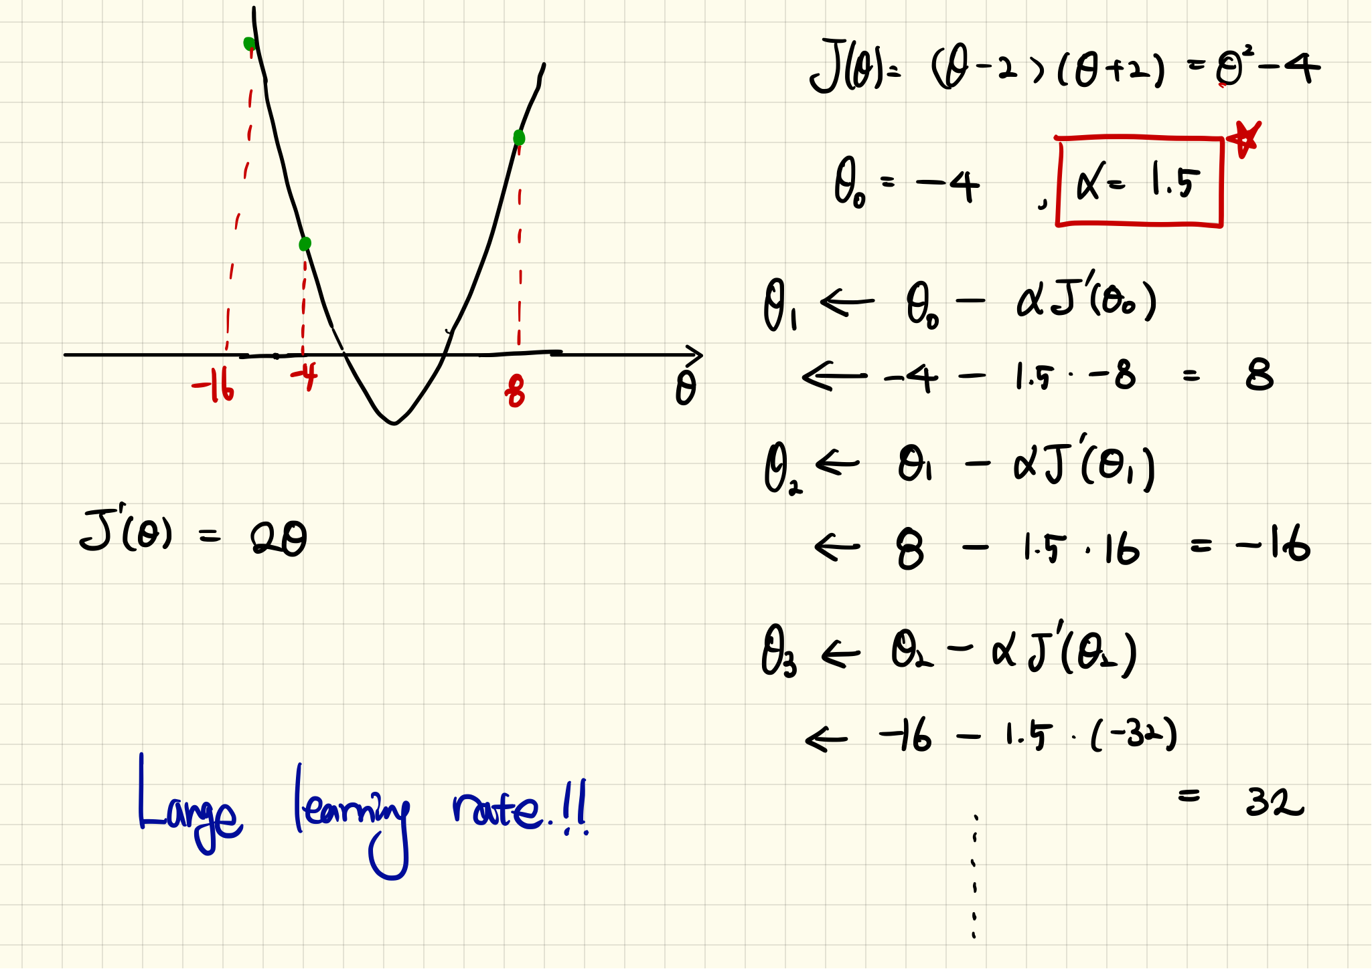
Example: Quadratic Function (Continue)

Slide 9
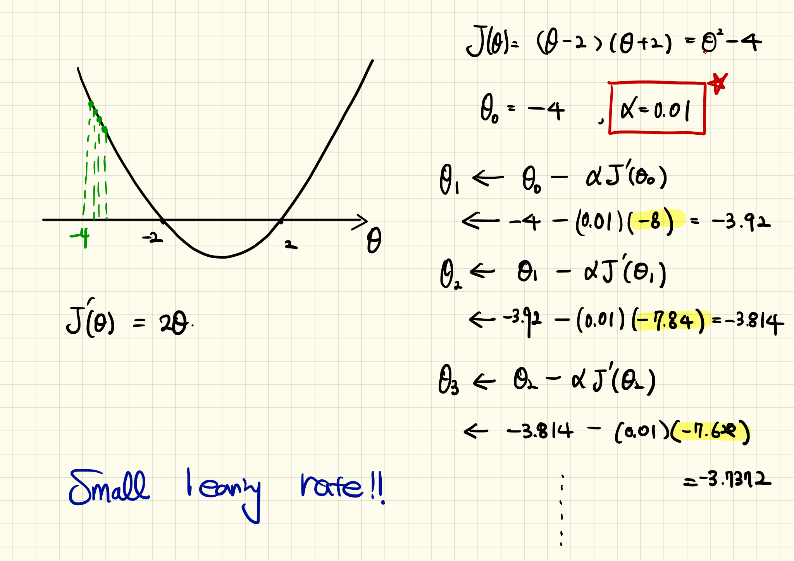
Example: Quadratic Function (Continue)

Slide 10
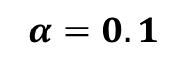
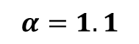
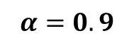
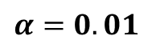
Example: Quadratic Function (Simulation)
10 iterations
$$α=0.1$$
$$α=0.01$$
$$α=1.1$$
$$α=0.9$$
See tutorials

Slide 11

Effect of Learning Rates

Slide 12
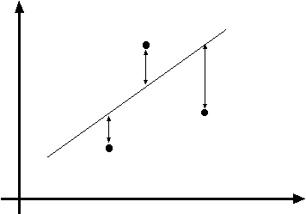
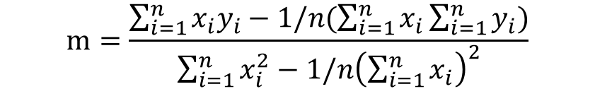
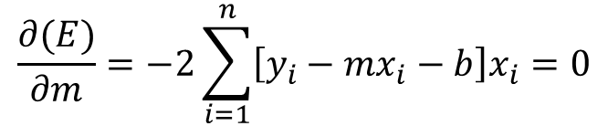
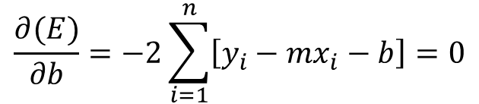
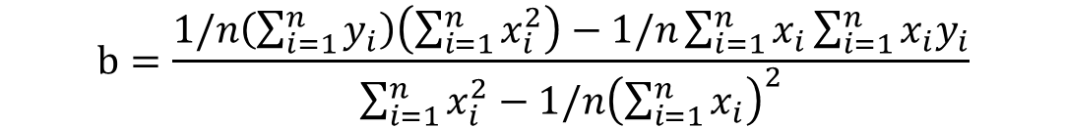
Recall: Least Squares Line Fitting
Data (measurement): (x₁, y₁), …, (x_{n}, y_{n})
Model: Line (y_{i} = m x_{i} + b)
Task: Find (m, b)
y=mx+b
(x_{i}, y_{i})
Minimize
$$m=\frac{\sum_{i=1}^{n}{x_{i}y_{i}−1/n(\sum_{i=1}^{n}{x_{i}}\sum_{i=1}^{n}{y_{i}})}}{\sum_{i=1}^{n}{x_{i}^{2}}−{1/n\left(\sum_{i=1}^{n}{x_{i}}\right)}^{2}}$$
$$\frac{∂(E)}{∂m}=−2\sum_{i=1}^{n}{\left[y_{i}−mx_{i}−b\right]x_{i}}=0$$
$$b=\frac{1/n\left(\sum_{i=1}^{n}{y_{i}}\right)\left(\sum_{i=1}^{n}{x_{i}^{2}}\right)−1/n\sum_{i=1}^{n}{x_{i}}\sum_{i=1}^{n}{x_{i}y_{i}}}{\sum_{i=1}^{n}{x_{i}^{2}}−{1/n\left(\sum_{i=1}^{n}{x_{i}}\right)}^{2}}$$
$$\frac{∂(E)}{∂b}=−2\sum_{i=1}^{n}{\left[y_{i}−mx_{i}−b\right]}=0$$

Slide 13
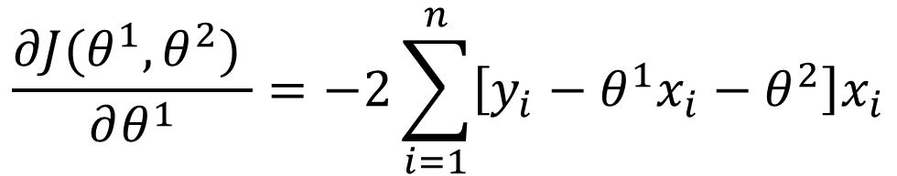
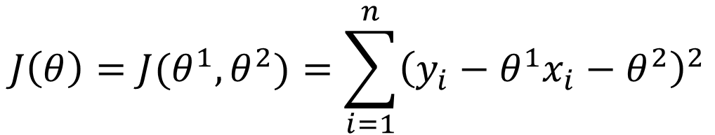
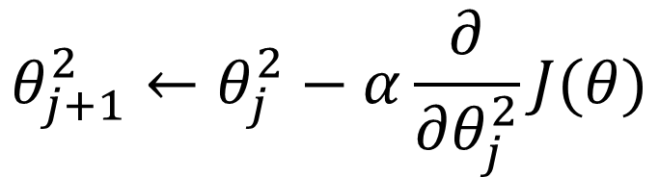
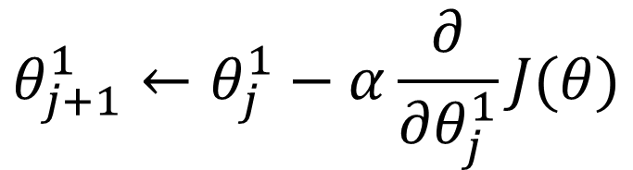
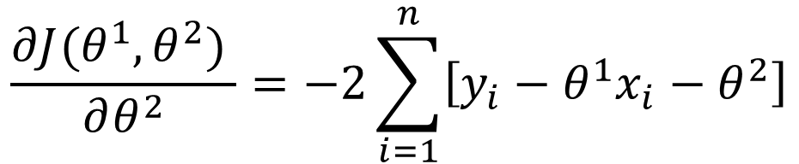
Line Fitting using Gradient Descent
Cost function:
$$J\left(θ\right)=J(θ^{1},θ^{2})=\sum_{i=1}^{n}{{\left(y_{i}−θ^{1}x_{i}−θ^{2}\right)}^{2}}$$
Derivatives:
Updated rules:
$$\frac{∂J(θ^{1},θ^{2}) }{∂θ^{1}}=−2\sum_{i=1}^{n}{\left[y_{i}−θ^{1}x_{i}−θ^{2}\right]x_{i}}$$
$$θ_{j+1}^{1}←θ_{j}^{1}−α\frac{∂}{∂θ_{j}^{1}}J(θ)$$
$$\frac{∂J(θ^{1},θ^{2}) }{∂θ^{2}}=−2\sum_{i=1}^{n}{\left[y_{i}−θ^{1}x_{i}−θ^{2}\right]}$$
$$θ_{j+1}^{2}←θ_{j}^{2}−α\frac{∂}{∂θ_{j}^{2}}J(θ)$$

Slide 14
Example: Line Fitting using Gradient Descent
Data (measurement): (1 4.2), (2, 6.8), (3, 10.1)
Model: Line (y_{i} = m x_{i} + b)
True model: y = 3x + 1
Task: Find (m, b)
Least square
$$m=\frac{\sum_{i=1}^{n}{x_{i}y_{i}−1/n(\sum_{i=1}^{n}{x_{i}}\sum_{i=1}^{n}{y_{i}})}}{\sum_{i=1}^{n}{x_{i}^{2}}−{1/n\left(\sum_{i=1}^{n}{x_{i}}\right)}^{2}}=\frac{\left(4.2+13.6+30.3\right)−1/3(6∗21.1) }{14−1/3(6∗6) }=\frac{5.9}{2 }=2.95$$
$$b=\frac{1/n\left(\sum_{i=1}^{n}{y_{i}}\right)\left(\sum_{i=1}^{n}{x_{i}^{2}}\right)−1/n\sum_{i=1}^{n}{x_{i}}\sum_{i=1}^{n}{x_{i}y_{i}}}{\sum_{i=1}^{n}{x_{i}^{2}}−{1/n\left(\sum_{i=1}^{n}{x_{i}}\right)}^{2}}=\frac{\frac{1}{3}∗21.1∗14−\frac{1}{3}∗6∗(4.2+13.6+30.3) }{2}=1.133$$

Slide 15
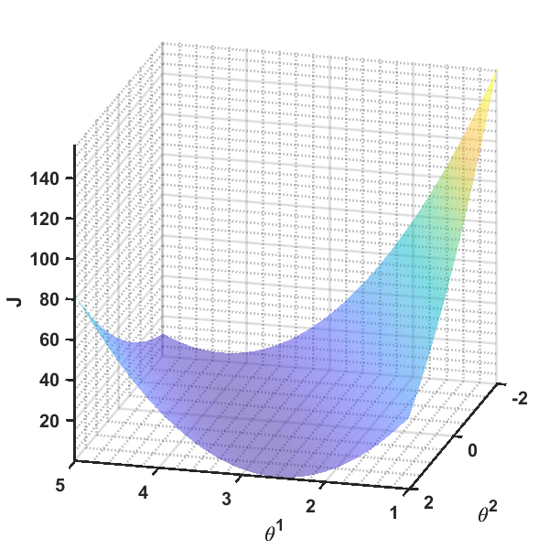
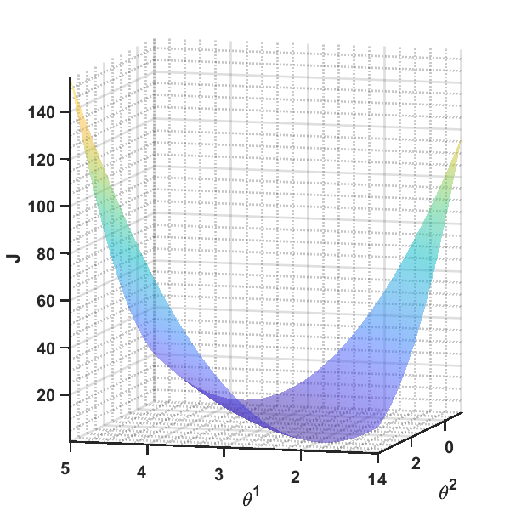
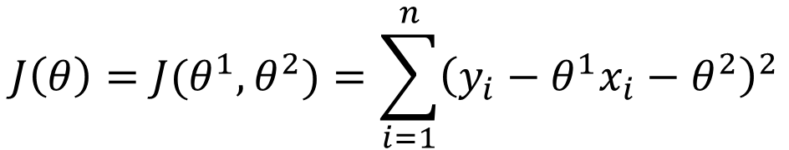
Example: Line Fitting using Gradient Descent (Continue)
Cost function:
$$J\left(θ\right)=J(θ^{1},θ^{2})=\sum_{i=1}^{n}{{\left(y_{i}−θ^{1}x_{i}−θ^{2}\right)}^{2}}$$

Slide 16
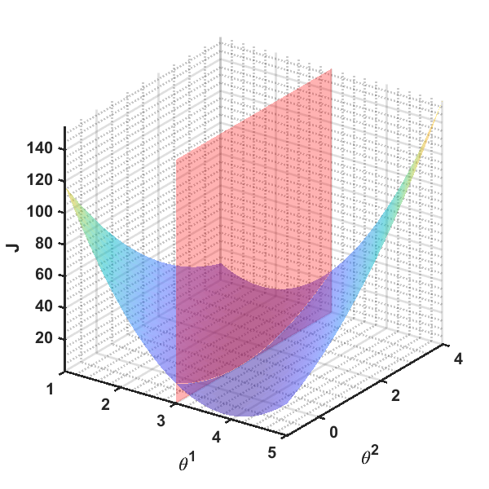
Example: Line Fitting using Gradient Descent (Continue)

Slide 17
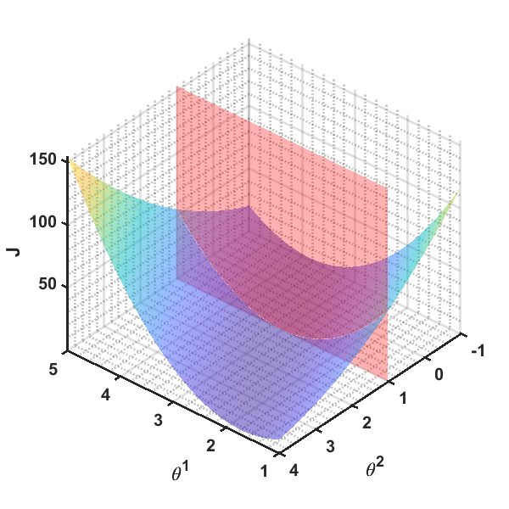
Example: Line Fitting using Gradient Descent (Continue)

Slide 18
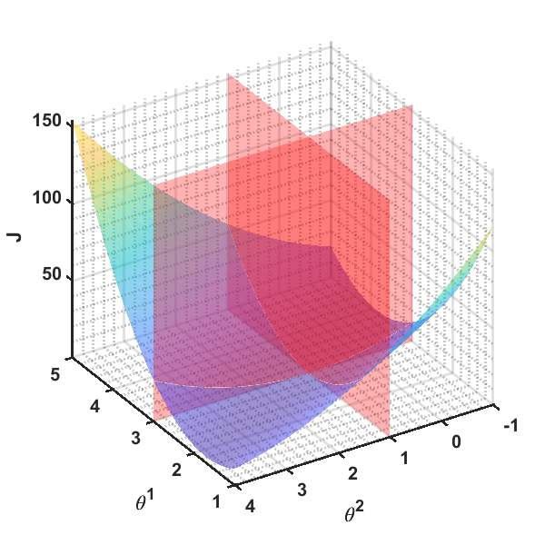
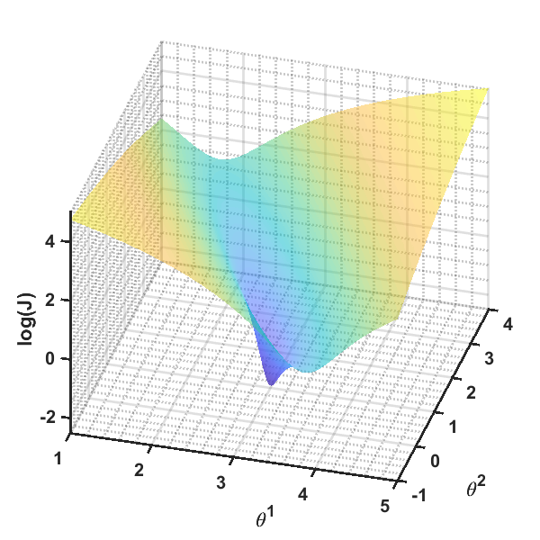

Slide 19
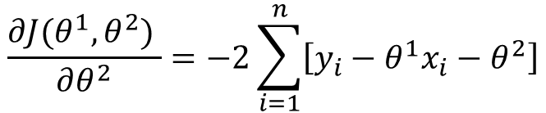
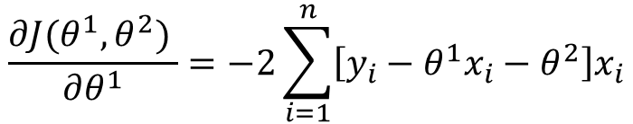
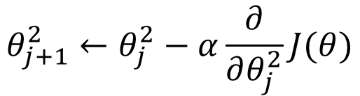
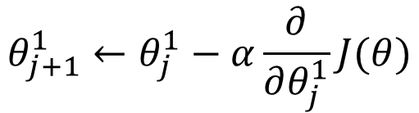
Example: Line Fitting using Gradient Descent (Continue)
$$\frac{∂J(θ^{1},θ^{2}) }{∂θ^{1}}=−2\sum_{i=1}^{n}{\left[y_{i}−θ^{1}x_{i}−θ^{2}\right]x_{i}}$$
$$θ_{j+1}^{1}←θ_{j}^{1}−α\frac{∂}{∂θ_{j}^{1}}J(θ)$$
$$\frac{∂J(θ^{1},θ^{2}) }{∂θ^{2}}=−2\sum_{i=1}^{n}{\left[y_{i}−θ^{1}x_{i}−θ^{2}\right]}$$
$$θ_{j+1}^{2}←θ_{j}^{2}−α\frac{∂}{∂θ_{j}^{2}}J(θ)$$
1 2 3 4 5 6 7 8 | in_data = [1 2 3]; out_data = [4.2 6.8 10.1]; itr = 12; l_r = 0.08; t1 = zeros(itr,1); t1(1) = 1; t2 = zeros(itr,1); t2(1) = 0;
9 10 11 12 13 14 15 16 | J1 = @(th1, t2) -2*sum((out_data-t1*in_data-t2).*in_data); J2 = @(th1, t2) -2*sum((out_data-t1*in_data-t2)); for ii=1:n_iter-1 t1(ii+1) = t1(ii) - l_r*J1(t1(ii), t2(ii)); t2(ii+1) = t2(ii) - l_r*J2(t1(ii), t2(ii)); end

Slide 20
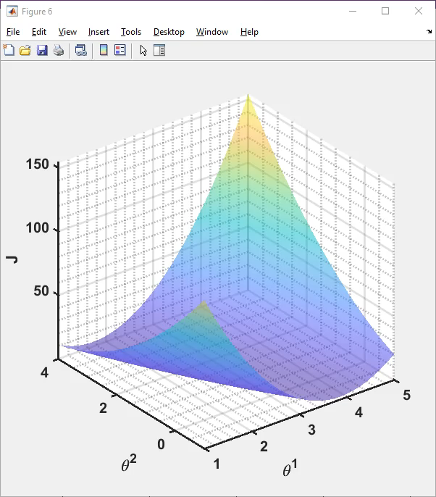

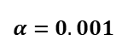
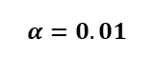
Iter. | 1 | 2 | 3 | 4 | 5 | 6 | 7 | 8 | 9 | 10 | 11 | 12
$$θ^{1}$$ | 1 | 1.682 | 2.1368 | 2.440011 | 2.642082 | 2.776673 | 2.866242 | 2.925774 | 2.965265 | 2.991388 | 3.008593 | 3.019848
$$θ^{1}$$ | 0 | 0.302 | 0.50404 | 0.639382 | 0.730217 | 0.791354 | 0.832672 | 0.860763 | 0.880024 | 0.893391 | 0.902821 | 0.909621
$$α=0.01$$
Iter. | 1 | 2 | 3 | 4 | 5 | 6 | 7 | 8 | 9 | 10 | 11 | 12
$$θ^{1}$$ | 1 | 1.0682 | 1.134128 | 1.19786 | 1.259468 | 1.319024 | 1.376595 | 1.432248 | 1.486047 | 1.538053 | 1.588325 | 1.636923
$$θ^{1}$$ | 0 | 0.0302 | 0.0594 | 0.087634 | 0.114934 | 0.141331 | 0.166855 | 0.191535 | 0.215398 | 0.238473 | 0.260786 | 0.282361
$$α=0.001$$

Slide 21
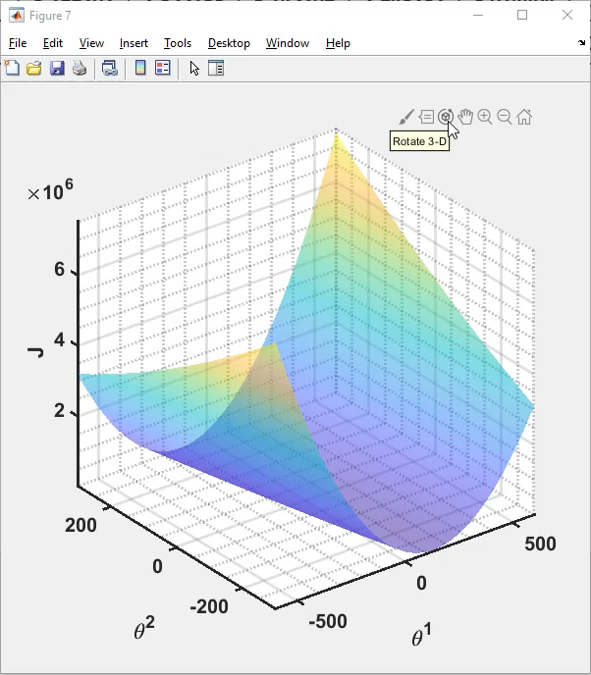

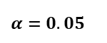
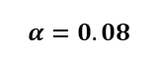
Iter. | 1 | 2 | 3 | 4 | 5 | 6 | 7 | 8 | 9 | 10 | 11 | 12
$$θ^{1}$$ | 1 | 6.456 | -2.6288 | 12.45853 | -12.6348 | 29.06521 | -40.2649 | 74.97162 | -116.597 | 201.8388 | -327.509 | 552.42
$$θ^{1}$$ | 0 | 2.416 | -1.56544 | 5.085619 | -5.93967 | 12.41676 | -18.0699 | 32.63401 | -51.6271 | 88.46348 | -144.388 | 242.7028
$$α=0.08$$
Iter. | 1 | 2 | 3 | 4 | 5 | 6 | 7 | 8 | 9 | 10 | 11 | 12
$$θ^{1}$$ | 1 | 4.41 | 2.14 | 3.6414 | 2.63902 | 3.299202 | 2.855733 | 3.145209 | 2.948232 | 3.074404 | 2.98619 | 3.040475
$$θ^{1}$$ | 0 | 1.51 | 0.521 | 1.1907 | 0.75865 | 1.057643 | 0.870829 | 1.00614 | 0.927173 | 0.990081 | 0.958415 | 0.989177
$$α=0.05$$

Slide 22
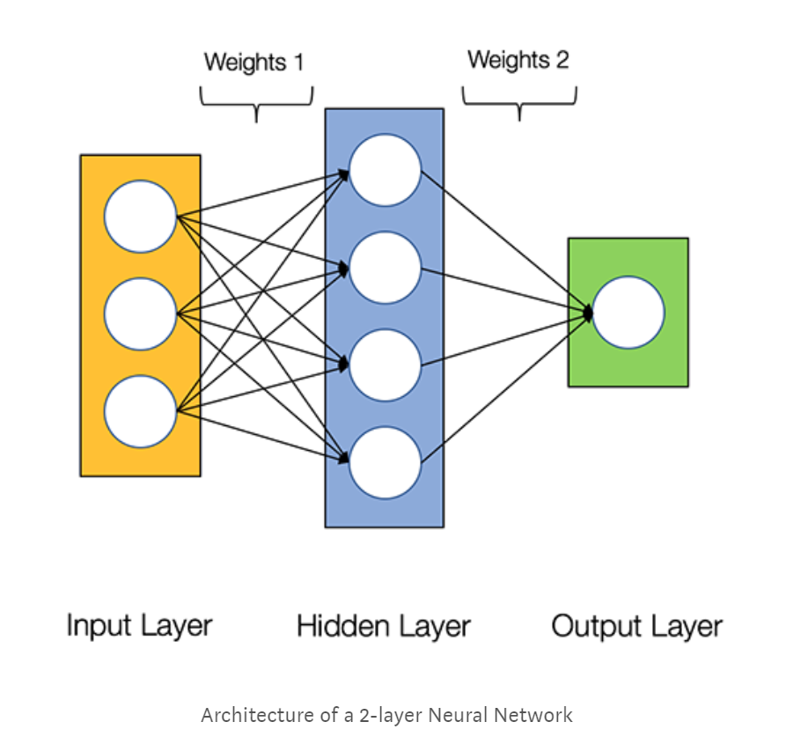
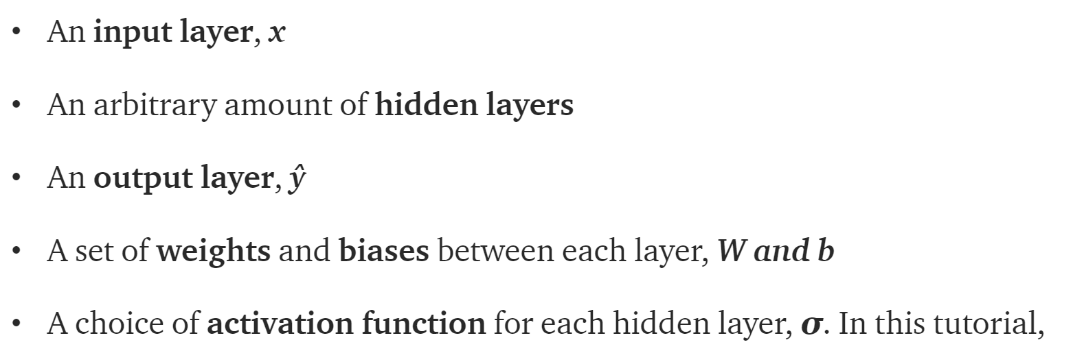
What’s a Neural Network

Slide 23
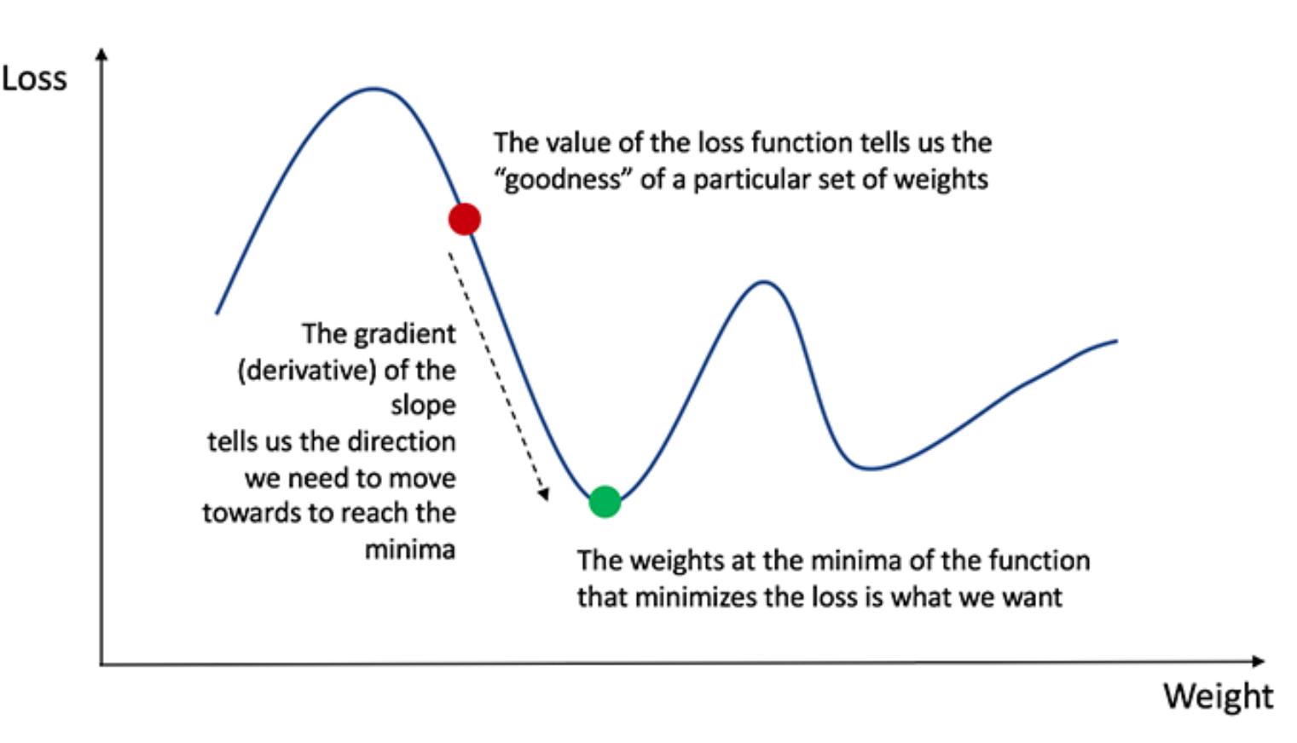
Training the Neural Network
Naturally, the right values for the weights and biases determines the strength of the predictions. The process of fine-tuning the weights and biases from the input data is known as training the Neural Network.
Our goal in training is to find the best set of weights and biases that minimizes the loss function.
Calculating the predicted output y, known as feedforward
Updating the weights and biases, known as backpropagation

Slide 24
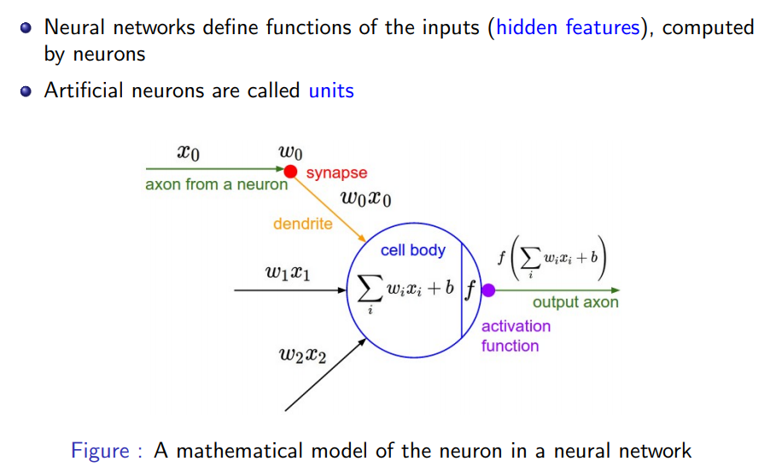
Mathematical Model of a Neuron

Slide 25
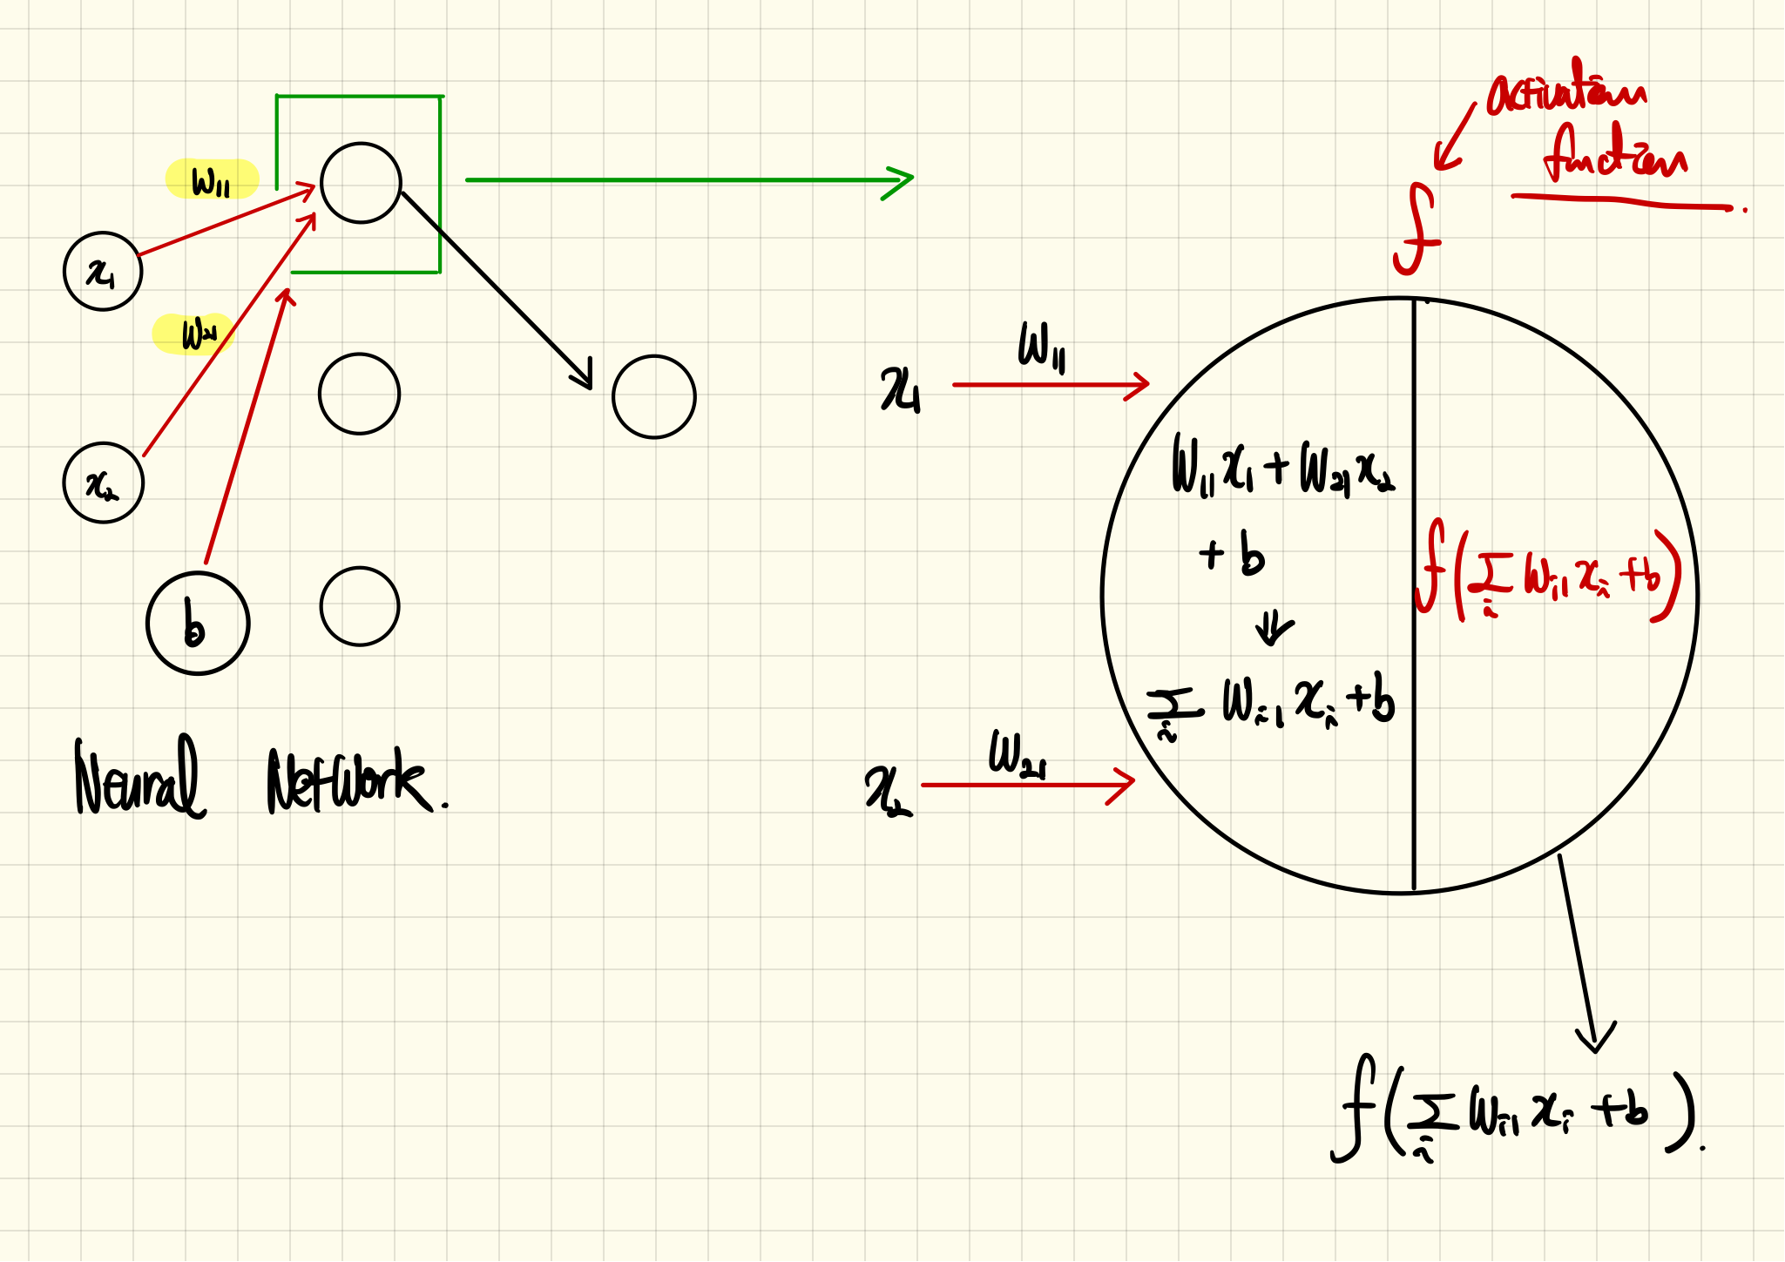
Mathematical Model of a Neuron (Continue)

Slide 26
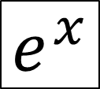
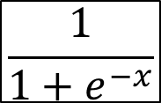
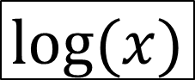
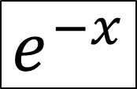
Some Functions
$$e^{x}$$
$$e^{−x}$$
$$\frac{1}{1+e^{−x}}$$
$$log⁡(x)$$

Slide 27
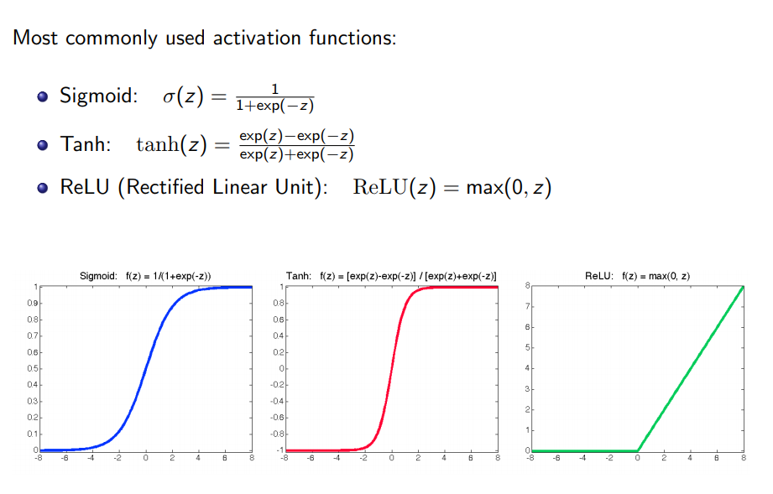
Activation Functions

Slide 28

Activation Functions and Their Derivatives
https://towardsdatascience.com/activation-functions-neural-networks-1cbd9f8d91d6

Slide 29
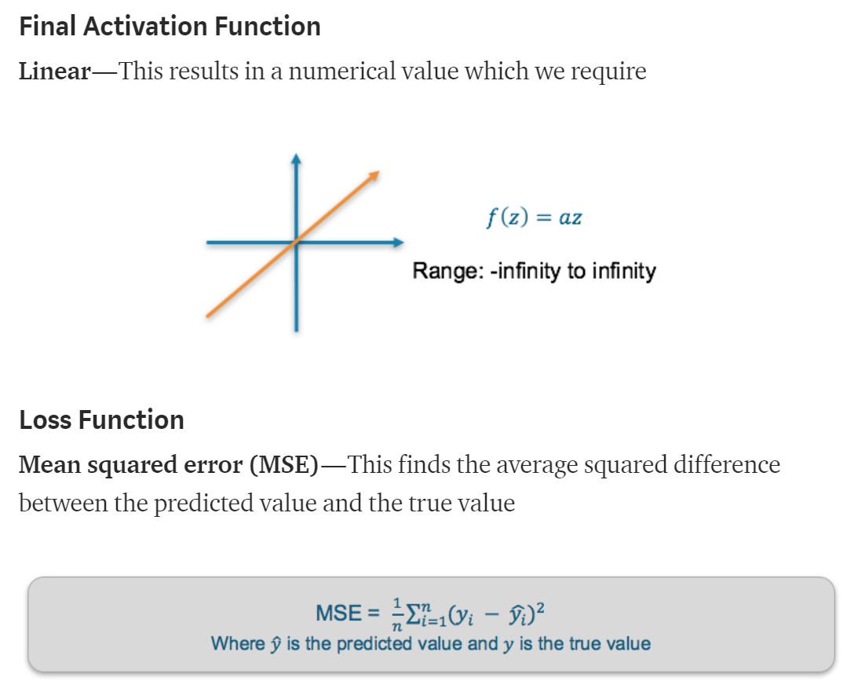
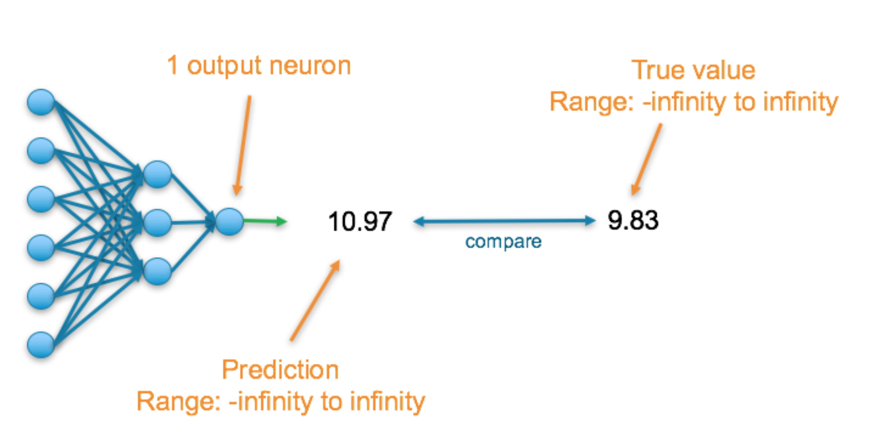
Loss Function
There are many available loss functions, and the nature of our problem should dictate our choice of loss function.
Regression

Slide 30


Loss Function (Continue)

Slide 31


Loss Function (Continue)

Slide 32

Softmax Function

Slide 33

A Step-by-step Forward and Backward Propagation
One hidden layer (two hidden neurons)
Two output neuron
Two input neuron
Activation function: Logistic function
Two input → Two output

Slide 34

Initial Weights, Biases, and Training Inputs/Outputs

Slide 35





Forward Pass
Logistic function

Slide 36



Forward Pass (Continue)

Slide 37




Calculating the Total Error
End of a forward pass

Slide 38
Backward Pass
Our goal with backpropagation is to update each of the weights in the network so that they cause the actual output to be closer the target output, thereby minimizing the error for each output neuron and the network as a whole. Our goal is to make the values in the red boxes 0.01 and 0.99, respectively by changing (updating) the weights.
0.3775
0.593
1.106
0.751
0.393
0.596
1.224
0.773

Slide 39


Output Layer
Chain rule

Slide 40




Output Layer (Continue)

Slide 41

Output Layer (Continue)

Slide 42


Output Layer (Continue)

Slide 43



Output Layer (Continue)

Slide 44

Hidden Layer
W1, W2, W3, and W4 contribute both the E_{o1} and E_{o2}

Slide 45
What Did We Compute?
o2
o2
7
o2
o2
7
o2

Slide 46




Hidden Layer (Continue)
=

Slide 47



Hidden Layer (Continue)
=

Slide 48


Hidden Layer (Continue)

Slide 49

Hidden Layer (Continue)

Slide 50


Complete One Iteration (Forward and Back Propagation)

Slide 51


Another Example: A Step-by-step Forward and Backward Propagation
Two hidden layer
Three hidden neuron in each layer
Three output neuron
Three input neuron
Different activation functions
Three input → Three output
https://medium.com/@14prakash/back-propagation-is-very-simple-who-made-it-complicated-97b794c97e5c

Slide 52



Derivatives of Activation Functions

Slide 53

Initializing Network

Slide 54


Forward Propagation: Layer-1

Slide 55


Forward Propagation: Layer-2

Slide 56


Forward Propagation: Layer-3

Slide 57


Cross Entropy
https://stackoverflow.com/questions/36515202/why-is-the-cross-entropy-method-preferred-over-mean-squared-error-in-what-cases

Slide 58


Back Propagation: Layer-2 − Output

Slide 59

Back Propagation: Layer-2 − Output (Continue)

Slide 60

Back Propagation: Layer-2 − Output (Continue)

Slide 61

Back Propagation: Layer-2 − Output (Continue)

Slide 62


Back Propagation: Layer-2 − Output (Continue)

Slide 63


Back Propagation: Layer-1 − Layer 2

Slide 64


Back Propagation: Layer-1 − Layer 2 (Continue)

Slide 65


Back Propagation: Layer-1 − Layer 2 (Continue)

Slide 66


Back Propagation: Layer-1 − Layer 2 (Continue)

Slide 67




Gradient Descent Variants
Batch gradient descent: Batch Gradient Descent is when we sum up over all examples on each iteration when performing the updates to the parameters. Therefore, for each update, we have to sum over all examples:
Mini-batch gradient descent: Instead of going over all examples, Mini-batch Gradient Descent sums up over lower number of examples based on the batch size. Therefore, learning happens on each mini-batch of b examples:
Stochastic gradient descent: Instead of going through all examples, Stochastic Gradient Descent (SGD) performs the parameters update on each example (x^{i},y^{i}). Therefore, learning happens on every example:
https://towardsdatascience.com/gradient-descent-algorithm-and-its-variants-10f652806a3
https://medium.com/@montjoile/an-introduction-to-gradient-descent-algorithm-34cf3cee752b

Slide 68



Epoch vs Batch Size vs Iterations
https://towardsdatascience.com/epoch-vs-iterations-vs-batch-size-4dfb9c7ce9c9

Slide 69

https://ml-cheatsheet.readthedocs.io/en/latest/gradient_descent.html
$$\text{https}\text{://}\text{mccormickml}\text{.}\text{com}\text{/2014/03/04/}\text{gradient}\text{−}\text{descent}\text{−}\text{derivation}\text{/}$$

